Slide 1
دورة تطوير تطبيقات الويب باستخدام ASP.Net
يقدمها: عمر عبدالكريم المناخلي
Notes:
(5) Omar Abdelkerim | LinkedIn

Slide 2
Unit 1: Entity Framework

Slide 3

Outlines:
Setting the environment
ORM (Object-Relational Mapping) concept
Code First vs Database First Approaches
Data Annotations vs Fluent API
Migrations and Database Management
CRUD Operations
LINQ Queries with EF Core

Slide 4
Setting up the Environment

Slide 5
Software requirements:
  Visual Studio (Community Edition)
  Visual Studio Community | Download Latest Free Version
  MS SQL Server 2022 Express
  Download Microsoft® SQL Server® 2022 Express from Official Microsoft Download Center
  SQL Server Management Studio
  https://aka.ms/ssms/21/release/vs_SSMS.exe
https://youtu.be/zzLr5VxVf4o?si=bFPV2YBCakWqUv4P
How To Install SQL Server on Mac (M1 | M2 | M3) – YouTube

Slide 6
Intro to ORM and EF Core

Slide 7
Learning Objectives
By the end of this lesson, you will be able to:
  Understand what ORM means and why it's used.
  Describe the benefits of Entity Framework Core.
  Identify real-world use cases in web development.
  Set up EF Core in a project.

Slide 8
What is ORM?
ORM = Object-Relational Mapping
It’s a technique to convert data between C# objects and relational databases (e.g., SQL Server).
💡 Without ORM:
You write raw SQL, manually map data.
💡 With ORM:
You interact with objects, and the ORM handles SQL for you.

Slide 9
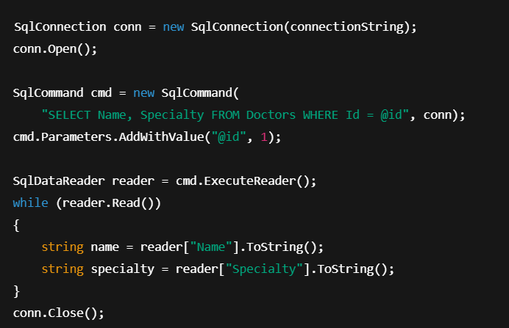
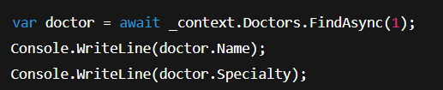
With vs. Without
💡 ORM handles:
  Opening/closing connections
  Parameterized queries (security)
  Data conversion (reader → object)

Slide 10
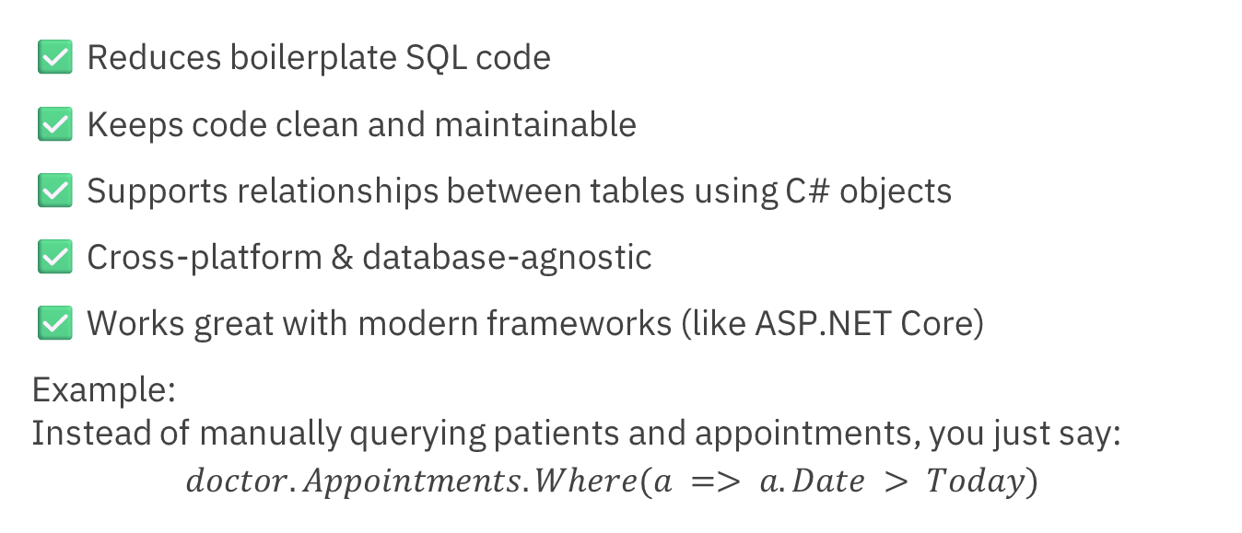
Why Use ORM?
✅ Reduces boilerplate SQL code
✅ Keeps code clean and maintainable
✅ Supports relationships between tables using C# objects
✅ Cross-platform & database-agnostic
✅ Works great with modern frameworks (like ASP.NET Core)
Example:
Instead of manually querying patients and appointments, you just say:
$$doctor.Appointments.Where(a => a.Date > Today)$$

Slide 11
What is Entity Framework Core?
EF Core is Microsoft’s modern, lightweight, cross-platform ORM.
Supports LINQ queries, migrations, relationship mapping, etc.
Works with SQL Server, PostgreSQL, SQLite, and more.
🎯 We’ll use EF Core in this course to:
  Create a Patient/Doctor/Appointment schema
  Perform CRUD operations
  Query data using LINQ

Slide 12
EF Core Architecture Overview
EF Core
Database
C# Classes
EF Core acts as a bridge between your application and your database.

Slide 13
ORM in Real Life – Clinic Use Case
Let’s say you’re building a clinic appointment system.
Entities:
  Doctor
  Patient
  Appointment
EF Core helps you:
  Save new appointments
  Link patients to doctors
  Retrieve upcoming visits with just a few lines of C# code

Slide 14
Alternatives to EF Core
While EF Core is great, other ORMs exist:
Dapper (lightweight, faster)
NHibernate (older, powerful)
ADO.NET (manual, low-level)
But:
🔷 EF Core = best choice for ASP.NET Core projects
→ Because it's fully integrated, actively supported by Microsoft, and designed to work seamlessly with ASP.NET Core’s modern architecture.

Slide 15
EF Core Approaches
📌 Code First vs. Database First

Slide 16
Learning Objectives
By the end of this lesson, you will:
  Understand the difference between Code First and Database First.
  Know when to use each approach.
  Identify the best choice for new ASP.NET 8 projects.
  Prepare your project for Code First development.

Slide 17
What Are EF Core Approaches?
Entity Framework Core offers two primary ways to work with the database:
Approach | Starts From | Tools Used
🟩 Code First | C# Classes | Visual Studio, Migrations
🟦 Database First | Existing DB | EF Tools: Scaffold-DbContext

Slide 18
Database First Approach
You start from an existing SQL database,
then scaffold C# classes from it.
✅ Good for:
  Legacy systems
  Big existing databases
⛔ Not flexible for evolving designs

Slide 19
Database First Example
👨‍⚕️ Imports tables like Patient, Appointment, Doctor as C# classes
Scaffold-DbContext "your-connection-string" Microsoft.EntityFrameworkCore.SqlServer -OutputDir Models
🧩 Required Libraries (NuGet):
  Microsoft.EntityFrameworkCore.SqlServer
  Microsoft.EntityFrameworkCore.Tools
Notes:
Scaffold-DbContext "Server=YOUR_SERVER;Database=YOUR_DB;Trusted_Connection=True;TrustServerCertificate=True;" Microsoft.EntityFrameworkCore.SqlServer -OutputDir Models
Dotnet ef dbcontext scaffold "Server=YOUR_SERVER;Database=YOUR_DB;Trusted_Connection=True;TrustServerCertificate=True;" Microsoft.EntityFrameworkCore.SqlServer –output-dir Models
EF Core tools reference (Package Manager Console) - EF Core | Microsoft Learn
dotnet add package PackageName

Slide 20
Code First Approach
You start by writing C# classes (entities), then generate the database schema.
✅ Good for:
  New projects
  Agile development
  Git versioning
  Building from domain models
💡 We'll use this in the course.

Slide 21
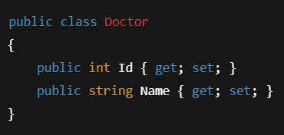

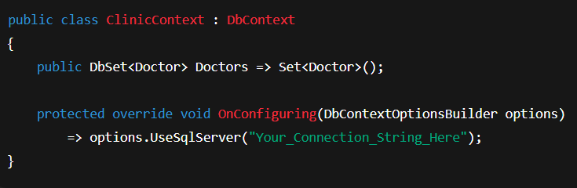
Code First Example
🎯 Database gets created automatically!
1. Create entity & DbContext classes
2. Run Command in PM Console

Slide 22
Which One to Choose?
🎯 Use Code First if:
  You’re starting a new ASP.NET 8 project
  You want full control over design and evolution
Feature | Code First | Database First
Agile & modern dev | ✅ | ❌
Reverse engineering existing DB | ❌ | ✅
Better for teams & Git | ✅ | ❌
Used in this course | ✅ | ❌

Slide 23
Modeling with EF Core
📌 Data Annotations vs Fluent API

Slide 24
Learning Objectives
By the end of this lesson, you will:
  Create entity models for your database.
  Use Data Annotations to define constraints and relationships.
  Use Fluent API to configure complex mappings.
  Know when to use each approach.

Slide 25
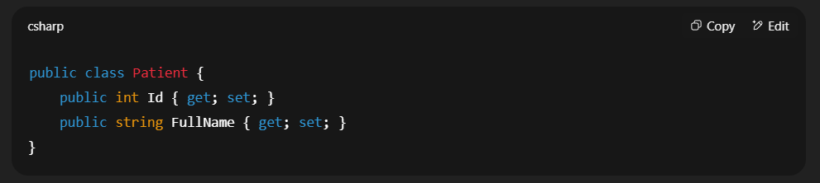
What Are Entity Models?
In EF Core, models = C# classes that represent your database tables.
Example: Doctor, Patient, Appointment
EF Core maps these to SQL tables.

Slide 26
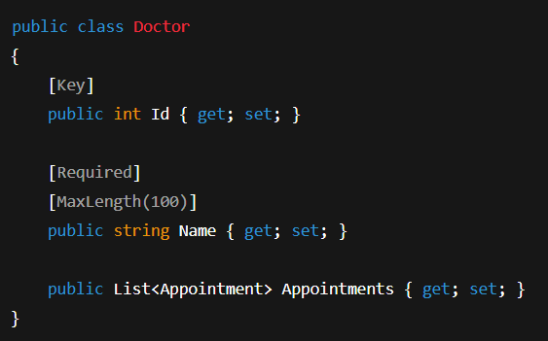
What Are Data Annotations?
Attributes placed directly on properties to configure:
  Primary keys
  Required fields
  String lengths
  Relationships
✅ Easy and readable
⛔ Limited flexibility

Slide 27
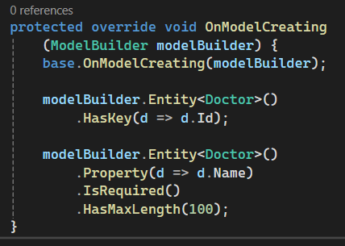
What Is the Fluent API?
Configuration done inside OnModelCreating using method chaining.
✅ Powerful for complex rules
✅ Keeps models clean
⛔ Less readable for beginners

Slide 28

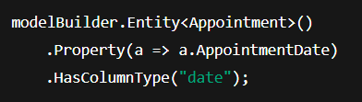
More Examples: (Column Type)
📝 Data Annotations
🔧 Fluent API

Slide 29
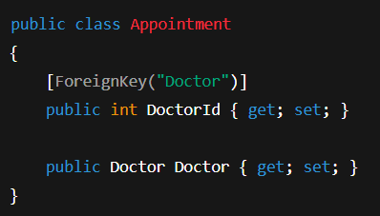
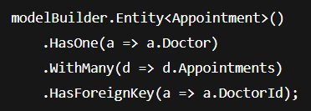
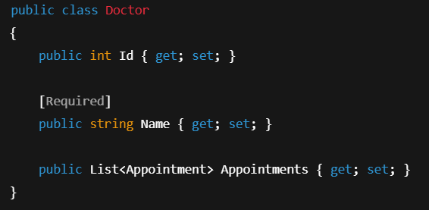
More Examples: (One-to-Many Relationship)
📝 Data Annotations
🔧 Fluent API

Slide 30


More Examples: (Ignore Property)
📝 Data Annotations
🔧 Fluent API

Slide 31
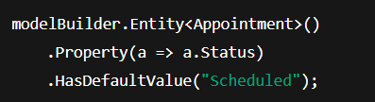
More Examples: (Set Default Value)
📝 Data Annotations
🔧 Fluent API

Slide 32
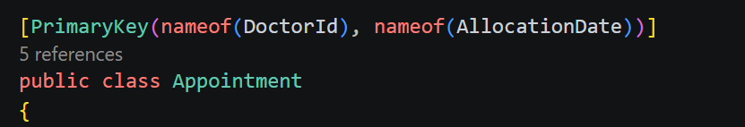

More Examples: (Composite Key)
📝 Data Annotations
🔧 Fluent API

Slide 33
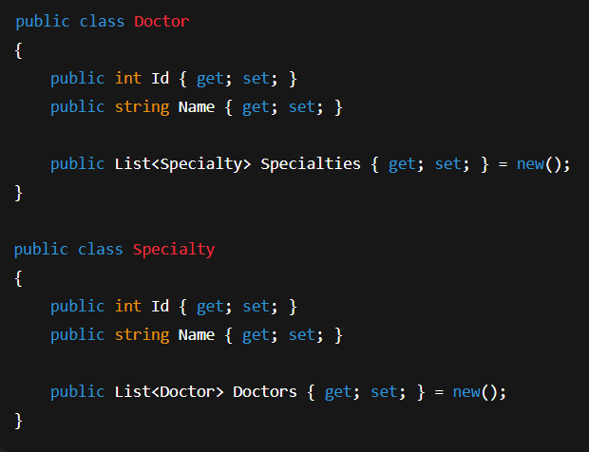
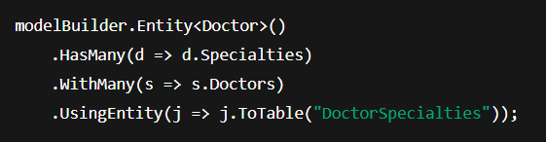
More Examples: (Many-to-Many Relationship)
📝 Data Annotations
🔧 Fluent API

Slide 34
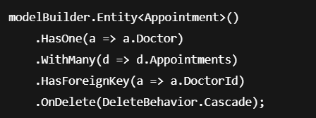
More Examples: (Delete Behavior)
📝 Data Annotations
🔧 Fluent API

Slide 35
Data Annotations vs Fluent API – Comparison
Feature | Data Annotations | Fluent API
Simplicity | ✅ Easy | ❌ More complex
Reusability | ❌ Mixed in model | ✅ Centralized in DbContext
Control | ❌ Limited | ✅ Full control
Best for | ✅ Quick setups | ✅ Advanced configs

Slide 36
Best Practices
✅ Use Data Annotations for basic validation & simple mapping.
✅ Use Fluent API for:
  Check Constraints
  Adding Default Values
  Cascade behavior
  Navigation mapping
💡 You can mix both — but prefer one style per project.

Slide 37
Migrations and Database Creation

Slide 38
Learning Objectives
By the end of this lesson, you will:
  Understand what migrations are in EF Core
  Create and apply migrations
  Keep your database schema in sync with your models
  Use CLI tools to generate and update your DB

Slide 39
What Are Migrations?
Migrations are a way to track changes in your model classes (like Doctor, Patient, Appointment)
EF Core generates a versioned C# migration file
EF Core generates SQL scripts based on those changes
You can apply these changes to your database using simple commands
🧠 Think of it as version control for your database schema

Slide 40
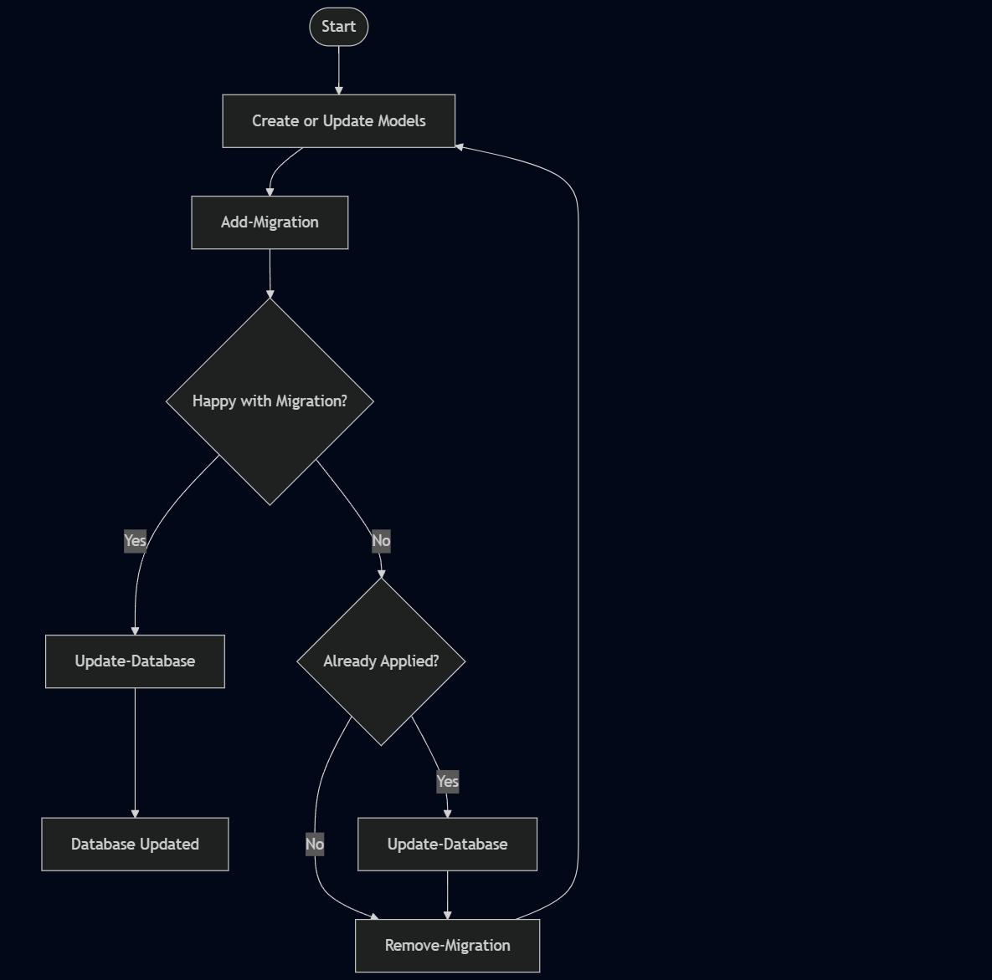
Migration Workflow

Slide 41
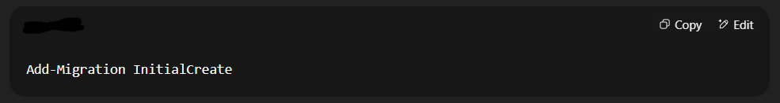
Creating Your First Migration
🧠 This generates a Migrations folder containing:
  Model snapshot
  Versioned migration files

Slide 42
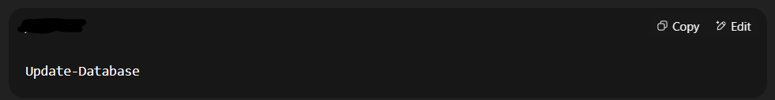
Applying the Migration
✅ This creates your SQL database with:
  Tables (Doctor, Patient, Appointment)
  Primary/foreign keys
  Column constraints

Slide 43
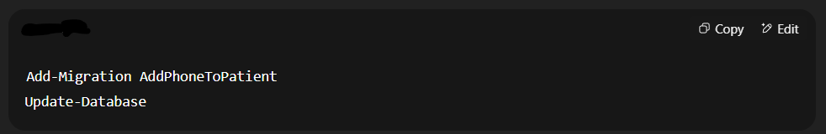
Modifying Your Schema
If you add a property (e.g., Patient.Phone):
💡 EF Core detects changes and creates C# migration file then apply the update.

Slide 44
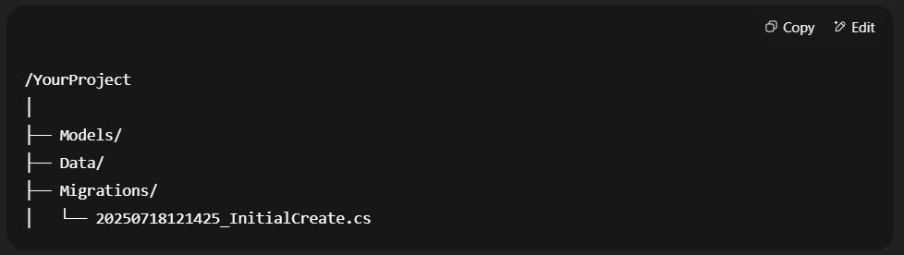
Folder Structure

Slide 45
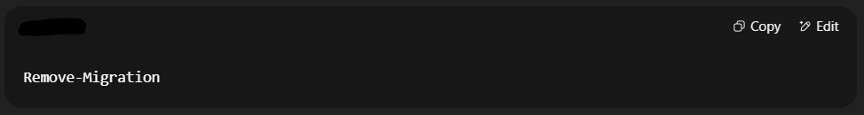
Removing a Migration
Sometimes you create a migration and realize there's a mistake — don’t worry!
There are two cases:
🟨 Case 1: You haven’t run Update-Database yet
You can safely remove the last migration:
✅ This deletes the latest migration file

Slide 46
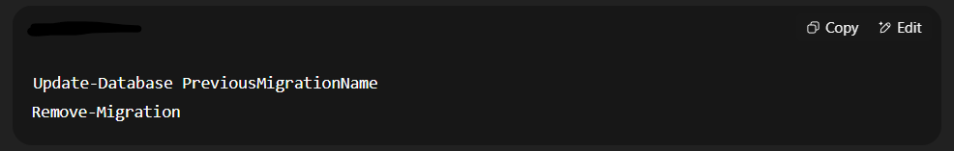
Removing a Migration
🟥 Case 2: You already ran Update-Database
You need to:
Roll back the DB
Then remove the migration
🔁 Replace PreviousMigrationName with the name of the one before the unwanted ones.

Slide 47
Seeding Initial Data
What is Seeding?
Seeding means adding default records to your database when it is created or updated via a migration.
Useful for:
  Initial test data
  Reference data (e.g., specialties, roles)
  Bootstrapping the clinic system

Slide 48
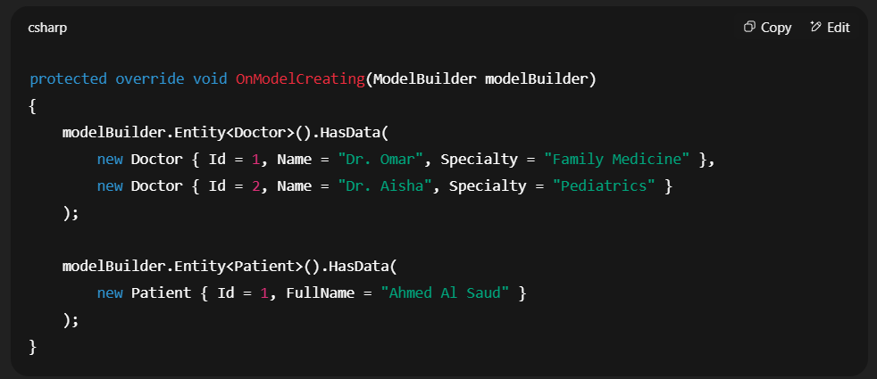
How to Seed Data in EF Core (Code First)
Override OnModelCreating in your DbContext:
Then add new migration

Slide 49
Best Practices
✅ Use clear names for each migration
✅ Always run Update-Database after Add-Migration
❌ Don’t edit migration files unless you're confident
✅ Commit migration files to Git

Slide 50
CRUD Operations using DbContext

Slide 51
Learning Objectives
By the end of this lesson, you will:
  Use DbContext to perform CRUD operations
  Understand how EF Core tracks and saves changes
  Apply CRUD in the context of a clinic appointment system

Slide 52
What is DbContext?
DbContext is the main class in EF Core to interact with the database.
It manages:
  Queries
  Tracking
  Saving changes
📌 Think of it as the gateway to your SQL Server database.

Slide 53
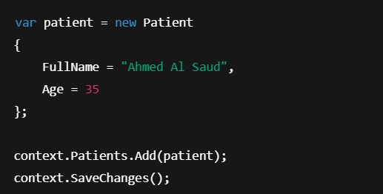
Create (Add New Record)
Add a new patient:
🧠 Add() stages the object, SaveChanges() persists it.

Slide 54


Read (Retrieve Records)
🔹 Get all doctors:
🔹 Find a doctor by ID:

Slide 55
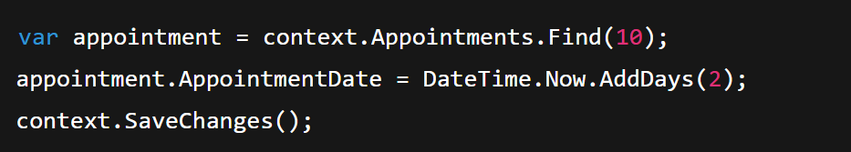
Update
Update appointment date:
🧠 EF Core tracks the change automatically.

Slide 56
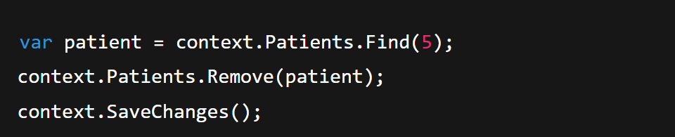
Delete
Delete a patient:
🔒 Always validate before deletion — don’t break foreign keys (e.g., if a patient has appointments).

Slide 57
LINQ Queries with EF Core

Slide 58
Learning Objectives
By the end of this lesson, you will:
  Understand what LINQ is and why it’s used
  Perform basic and advanced queries using LINQ
  Query relational data using EF Core
  Apply filters, projections, sorting, grouping — all using C#

Slide 59
What is LINQ?
LINQ (Language Integrated Query)
➡️ A feature in C# to query collections (like lists or DB sets) using a readable, SQL-like syntax.
EF Core allows you to write LINQ to query the database using:
  Strong typing
  IntelliSense support
  Compile-time validation

Slide 60
LINQ vs SQL
SQL | LINQ (Method Syntax)
SELECT * FROM Patients | context.Patients.ToList()
SELECT * FROM Appointments WHERE DoctorId = 1 | context.Appointments.Where(a => a.DoctorId == 1)
SELECT Name FROM Doctors | context.Doctors.Select(d => d.Name)
💡 LINQ is safer and easier to refactor than raw SQL.

Slide 61
Basic LINQ Queries in EF Core
🔹 Get All Patients:
🔹 Filter by Age:
🔹 Find by ID:

Slide 62
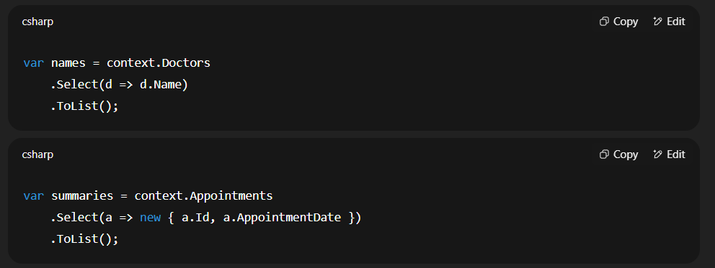
Selecting Specific Fields
✅ Great for performance (queries only needed columns)

Slide 63
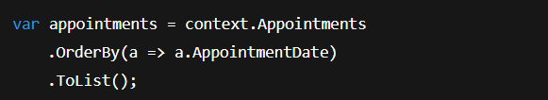
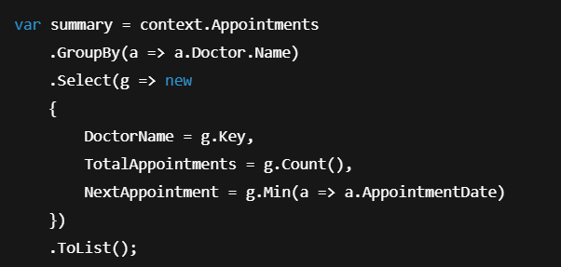
Sorting and Grouping
🔹 Order by Date:
🔹 Group by Doctor:

Slide 64
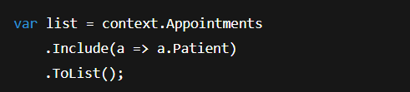
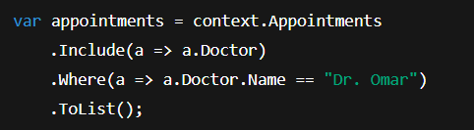
Querying with Navigation Properties
🔹 Get Appointments with Patient Info:
🔹 Filter by Doctor Name:

Slide 65
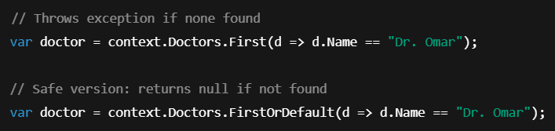

Count, First, Any, Exists

Slide 66
Best Practices
✅ Use Select to limit returned columns
✅ Use Include() for eager loading of related data
✅ Use AsNoTracking() for read-only queries
❌ Avoid loading everything with .ToList() too early — use .Where() first

Slide 67
شــــــكــــرًا لكــــــم
THANK YOU

